Slide 1

The Politics of Health Care in the United States
Dr. Vanessa Nicholson, Drph, mph
HLT 4320

Slide 2
Introduction
Health care is the nation’s largest economic sector at $3.5 trillion in annual costs and approaching 20% of the US GDP
Despite the United States’ enormous spending on health care-the highest in the world-patient outcomes lag behind those of comparable countries

Slide 3
Health Care Infrastructure and Spending
The U.S. system of delivering and financing health care is the most complicated among advanced countries
Some nations like Great Britain, manage health care through the government; others, like Switzerland, rely on the private market (with government subsidizing for the least well-off)
Singapore, for example mix government-run care for low-income residents with a private system
The United States includes elements of all three
Treating patients and paying for those treatments are managed by different collections of institutions which complicates matters further

Slide 4
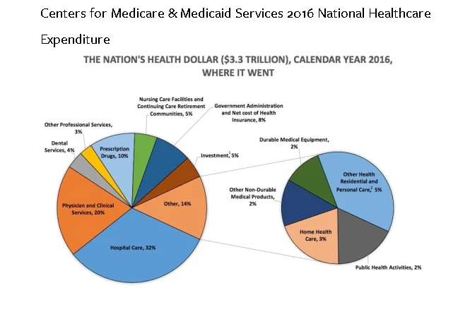

Slide 5
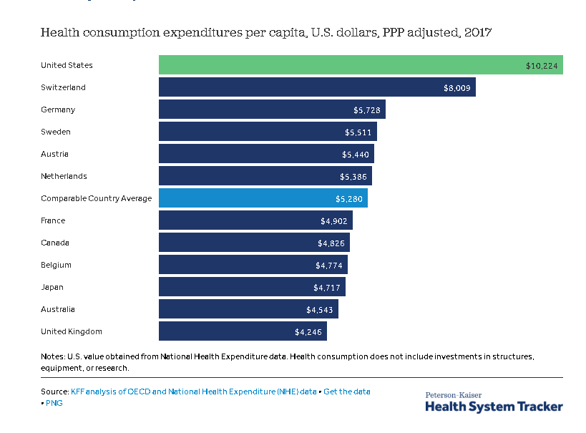

Slide 6
Present and Future
After a drop in annual increases after the Affordable Care Act (ACA’s) passage, costs have begun again to rise steadily with
A rise in prescription drug costs
Higher costs for out-of-pocket care
Rising Medicare expenses (as a large number of baby boomers age into the program and
ACA premium hikes (a consequence of executive branch regulatory actions designed to weaken the ACA)

Slide 7
Why do Americans pay so much for health care?

Slide 8
Because the US providers charge more for the same service. Without a single regulator negotiating prices, costs are simply passed along.

Slide 9
Understanding the Context on the Cost Rise of Health Care: Video
https://www.youtube.com/watch?v=3NvnOUcG-ZI

Slide 10
Pharmaceutical Companies
Pharmaceutical companies raised prices well beyond inflation with the advent of the Trump administration
After growing around 2% annually, drug costs leapt upward by 4.4% during 2017-2018
A study by Pharmacy Benefit Consultants (PBC) shows, 40 prescription drugs had price increases of more than 100% across the 15 months since January 2017; more than 225 drugs cost at least a third more (PBC, 2018)
Current projections are for annual drug cost increases of some 6.5% over the next decade
Pharmaceutical company representatives argue that higher costs are driven by increased use of specialty drugs to treat cancer and genetic disorders, but those skyrocketing fastest on PBC’s list include drugs for bee stings, bedwetting, and prescription skin cream

Slide 11
Pharmaceutical Companies
US drug costs more than twice as high as the average for other industrialized countries, a gap larger than that for nearly all other consumer goods
Public policy decision makers are a major reason
In contrast to most other countries, the American government guarantees extended monopolies to drug companies, with generic alternatives that would dramatically reduce prices often held up for years by litigation
Medicare’s initial passage included a compromise that involved the Centers for Medicare & Medicaid Services (CMS) cannot use its immense bulk-purchasing power to negotiate lower prices with drug manufacturers

Slide 12
Pharmaceutical Companies
CMS payment plans are also required by Congress to cover nearly all drugs, rather than concentrating on the most frequently prescribed (and/or cheaper) medications (Kesselheim, Avorn, and Sarpatwari, 2016)
Companies routinely claim that the high costs of research and development, along with long delays in Food and Drug Administration (FDA) approval of new drugs, keep their costs high
But academic analyses find at best missed evidence of association between R&D expenses and drug prices (Jaroslawski, etc. 2016) and the FDA’s swifter drug approval processes in recent years has not resulted in a commensurate price reduction of new pharmaceuticals

Slide 13
Pharmaceutical Companies
A final reason for unusually high prescription drug prices is the fragmentation of the industry. Drug companies utilize distributors for their products, who add a hefty premium to the price of every drug
Drug companies are not permitted to list their prices before the distributor markup
It is a fragmented system with opportunities for “investment.”

Slide 14
Pharmaceutical Companies: Summary
Across the first two-thirds of the century, America was among world leaders in terms of health outcomes, ranking near the top in areas like infant mortality and life expectancy
In recent decades, almost every wealthy nation has surpassed the United States on primary measures of mortality and morbidity
As we will explore for next class, these average measures, mask enormous differences between rich and poor

Slide 15
Patient Outcomes
Assessing health care systems is complex
Along with patient outcomes, analysts now evaluate health care system in four additional areas:
Access: Is health care available, timely, and affordable?)
Care process (including such vital aspects as patient safety, preventive care, coordinating care across different health providers, and health professionals’ engagement with patients)
Administrative efficiency (measuring whether the immense bureaucracy required to operate health systems work smoothly and swiftly)
Equity: (do all who seek care receive similar treatment?
From system efficiency through equity, the United States is a relatively low performer

Slide 16
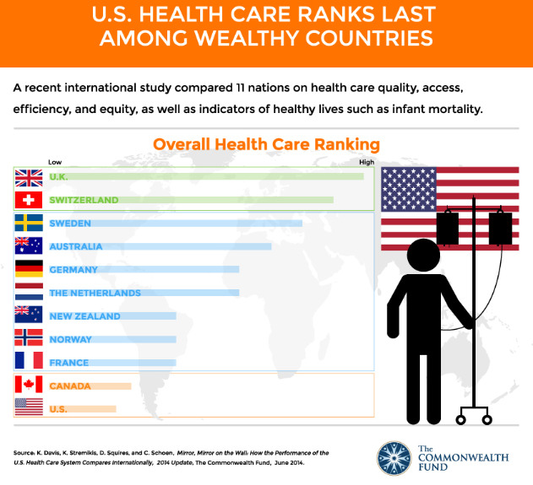

Slide 17
Management of Finances
Some 18% of the US GDP (all goods and services a nation produces) is devoted to health services, a percentage that continues to rise- and that is higher than peer nations, which typically spend around 10% of GDP on health care
Financing huge health costs involve a jumbled mixture of national, state, and local government; private insurance companies, individual payers; and private charities
The largest sources of health insurance in the US is the government

Slide 18
Management of Finances
Medicare ( a federal government program), Medicaid (joint state and federal, and other programs amount to 41% of insurance coverage
Together, these giant entitlement programs (only Social Security is larger) account for about $1.18 trillion in government spending , a figure expected to increase to $2 trillion by 2026
Private plans account for 34% of health care insurance
The next big slice is “out of pocket”
People pay at the point of service, either to cover cost sharing (which can run into thousands of dollars) or because they have no insurance

Slide 19
Politics of Providing Equitable Health Services
To date, “Obamacare” has extended coverage to some 20 million people, around two fifths of those uninsured before the ACA was enacted
Fifty-eight countries around the globe including nearly all US peer countries (wealthy democracies)) provide universal care- every resident is guaranteed access to the health care system by their government
Of the world’s 201 nations, 160 provide free health care: no cost to the patient
The US is among the small handful of countries (most of them lower income, like Liberia, Iraq, and Haiti) that do not provide free care and do not seek to cover all residents
One result is significant with health disparities in the United States

